Slide 1
Done by
Student Gleb Chekmarev
Form 7
School №24
Research adviser
Lydia K. Yuldasheva
Teacher of English

Slide 2
Phrasal verbs in English songs, or “cultural shock”

Slide 3
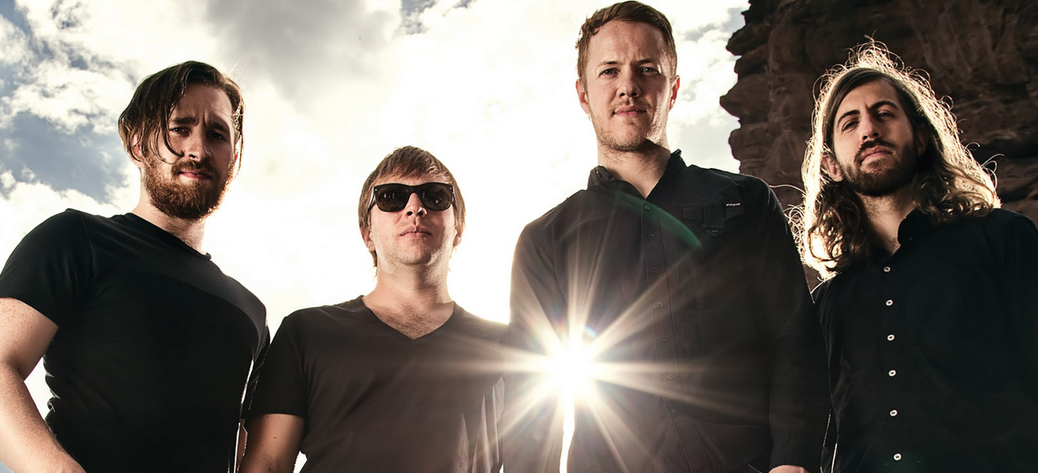
«Imagine Dragons» is my favourite band. It was formed in 2008, Dan Reynolds, Wayne Sermon, Ben McKee, Daniel Platzman.

Slide 4
Hypothesis of our research: having studied common prepositions we have a chance to guess the meaning of majority phrasal verbs

Slide 5
The goal of our research is to analyze all the phrasal verbs from 10 songs of «Imagine Dragons»

Slide 6
The tasks are:
To find out what phrasal verbs mean
To analyze the texts of the songs with phrasal verbs
To identify the most used postposition with verbs
To open up the meanings of the postpositions
To do a survey with students of 7th class

Slide 7
Methods of our research
Searching the information
Classification
Analysis
Comparison
Survey

Slide 8
Phrasal verbs in songs

Slide 9
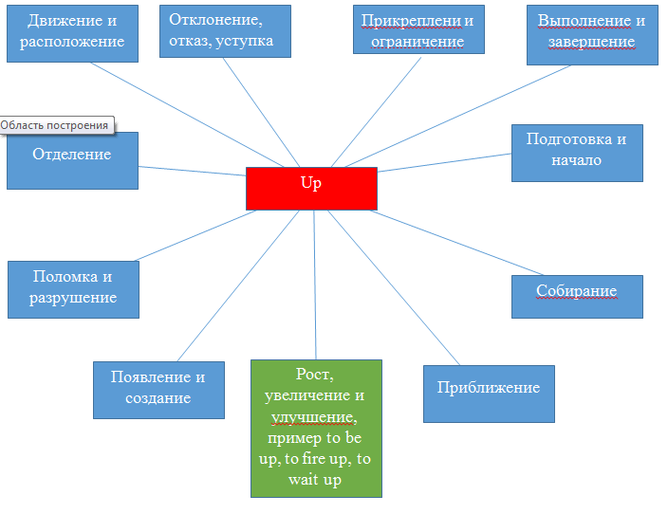

Slide 10
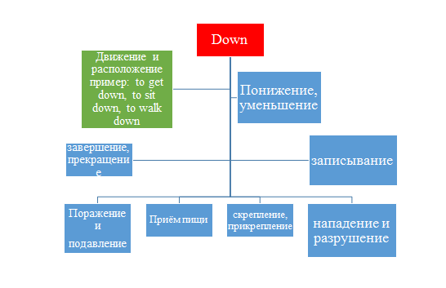

Slide 11
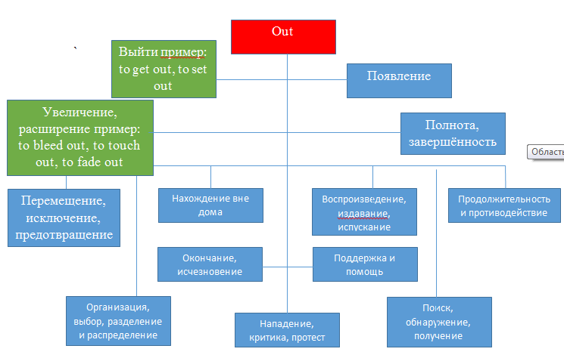

Slide 12
Are there phrasal verbs in Russian?

Slide 13
How many phrasal verbs in English?

Slide 14
Are there phrasal verbs in English songs or their take a part in a casual speech?

Slide 15
Would you like to know more about phrasal verbs?

Slide 16
Thanks for your attention

